Slide 1
Capstone Project The Battle of the Neighborhood
Applied Data Science Capstone by IBM/Coursera
Xiaoling Zhuang
Apr 21, 2021

Slide 2
Introduction
With the development of the global economy, more and more people change their places of residence due to the needs of study and work.
Case Intro:
Our client currently lives in the downtown Toronto, Ontario, Canada.
Looking for similar neighborhoods in Manhattan
Project Goal:
Use data science to help identify the most identical neighborhoods in Manhattan to the clients current residential area.
For Customers/readers who are interested in finding similar neighborhoods around the world.

Slide 3
Data Description
Data Sources :
Venues data of the targeted neighborhoods are from Foursquare.
The geographic location data of the Manhattan dataset can be downloaded from https://cf-courses-data.s3.us.cloud-object-storage.appdomain.cloud/IBMDeveloperSkillsNetwork-DS0701EN-SkillsNetwork/labs/newyork_data.json.
Data Pre-processing:
Collecting the Venues data of Downtown Toronto and Manhattan venues information using Foursquare API;
Using Pandas cleaning the data and combined the datasets.

Slide 4
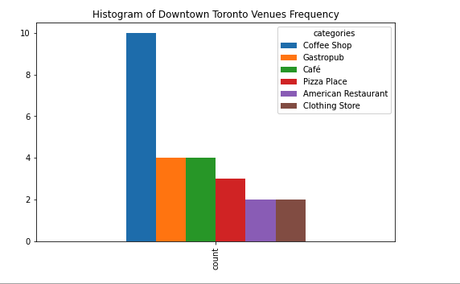
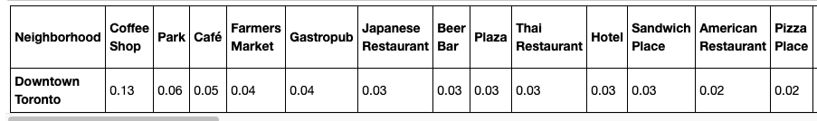
Explore the Client 's Current Neighborhood in Toronto

Slide 5
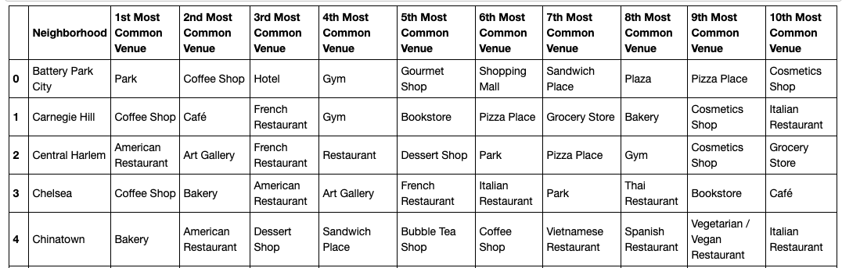
Explore the Neighborhoods in Manhattan, NYC

Slide 6
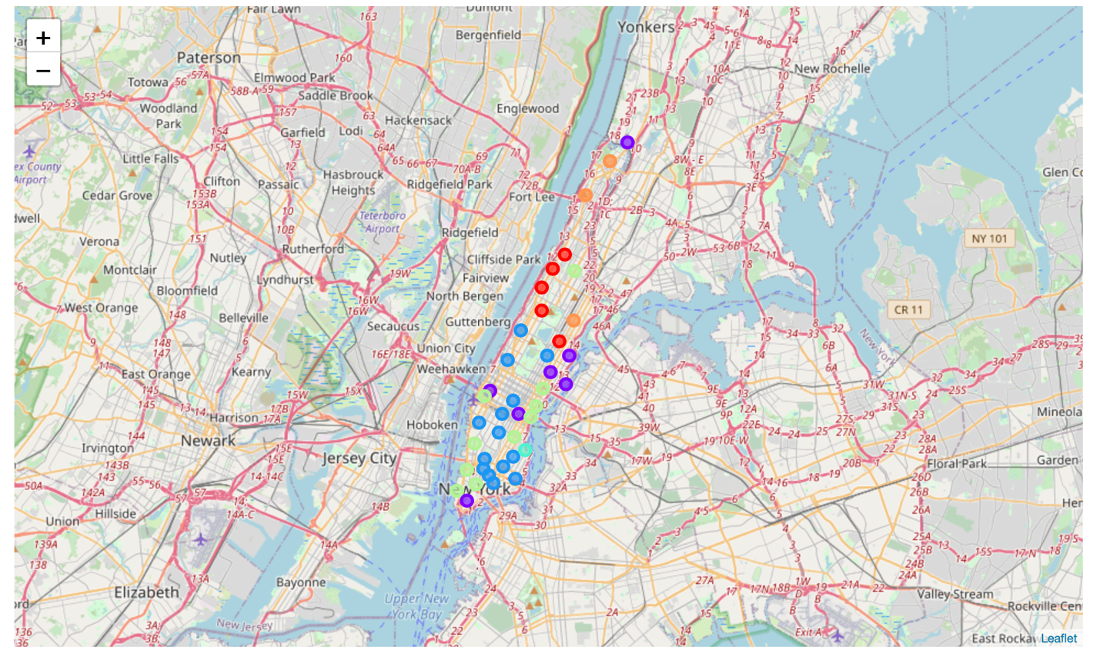
Cluster Analysis
There are totally 6 neighborhood clusters represented in different colors

Slide 7
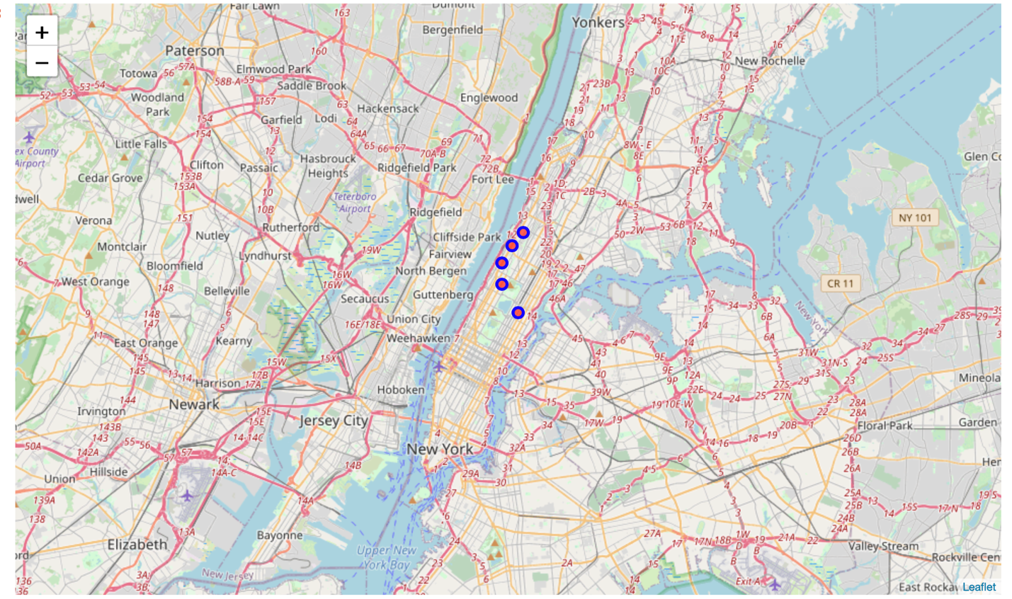
Discussion & Conclusion
The results show that Downtown Toronto is classified as cluster 0.
There are five neighborhoods in Manhattan that are similar to the Downtown Toronto: Carnegie Hill, Hamilton Heights, Manhattan Valley, Manhattanville, and Morningside Heights

Slide 8
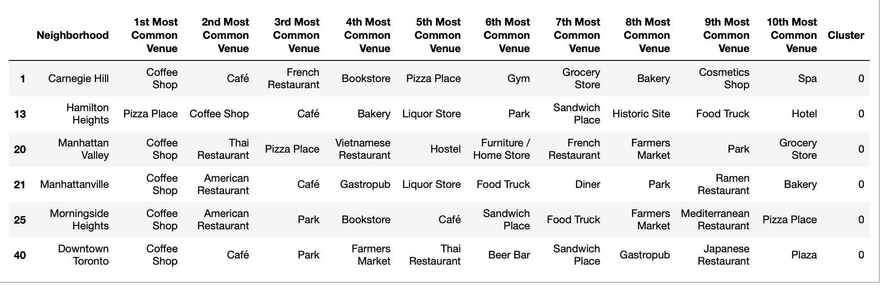
Discussion & Conclusion
the Morningside Heights neighborhood might be the most similar one to the Downtown Toronto neighborhood
It’s not only because it has the most distribution of Coffee shop and Café, but also, it’s the only neighborhood that has the Farmers Market, which venues is the fourth popular venues in Downtown Toronto.

Slide 9
Thank You!

